Slide 1
Techorama Café Blazor
Microsofts newest web UI

Slide 2

Web front-end development

Slide 3
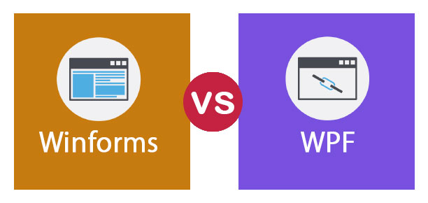
Good old days

Slide 4

Enter Blazor
Full-stack web dev with C# and Razor
JS and DOM access
Share code and libraries
Component ecosystem
Open-source and free
Run (almost) anywhere

Slide 5
Demo
A tour of Blazor

Slide 6
Razor components
Parameters
Fragment (ChildContent)
Templates
Splatting
Event binding
Lambda
Callbacks
Two-way data binding
Bind input to properties
No auto rerender
Lifecycle
OnInitialized(Async)
OnParametersSet(Async)
OnAfterRender(Async)
Rendering
Virtual DOM diffing
ShouldRender
StateHasChanged
Forms and validation
Data annotations
Routing
Page
Parameters

Slide 7
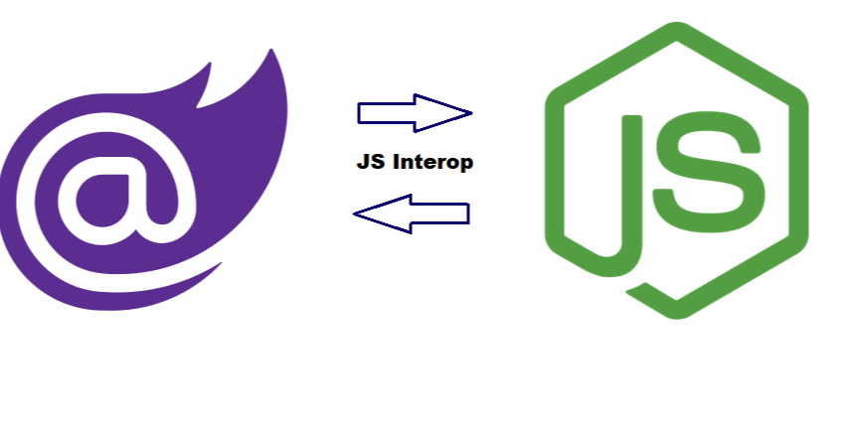
Blazor Javascript interop
JsRuntime.InvokeAsync<string>(…)
DotNet.invokeMethodAsync(…)

Slide 8
No big bang
Supported
Use components from MVC
Mix MVC routes and Blazor pages
Limitations
Use MVC from components

Slide 9

Blazor ecosystem
Telerik
DevExpress
Syncfusion
Radzen

Slide 10

Hosting & Runtime

Slide 11



Blazor hosting
Client-side
Server-side
https://...
https...
ASP.NET Core
Razor Components
DOM
SignalR
DOM
.NET
WebAssembly
Razor Components
.NET
Future
.NET Core 3.0
Notes:
https://mybuild.techcommunity.microsoft.com/sessions/77033?source=sessions

Slide 12

WEB ASSEMBLY
“WebAssembly (abbreviated Wasm) is a binary instruction format for a stack-based virtual machine. Wasm is designed as a portable target for compilation of high-level languages like C/C++/Rust, enabling deployment on the web for client and server applications.”
Browser
Javascript
.NET
Web
Assembly
C++
compile to
…

Slide 13
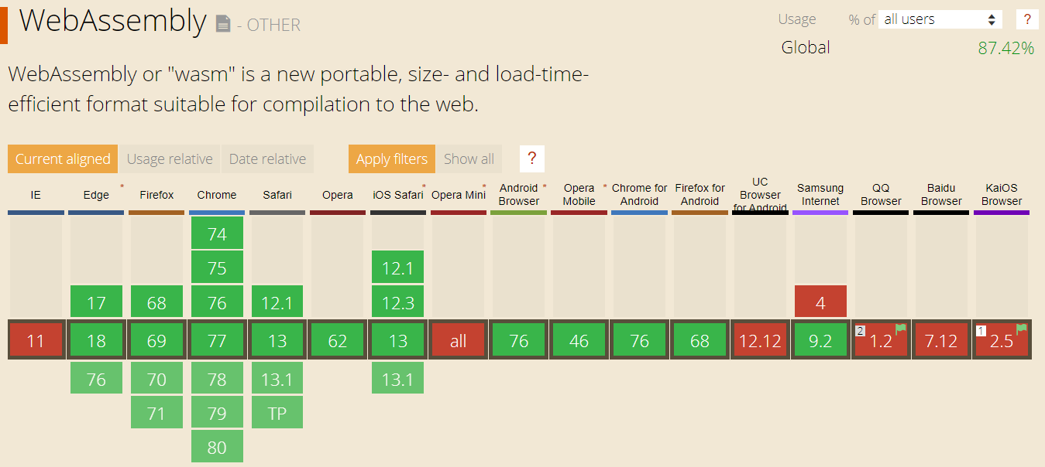
WEB ASSEMBLY browser support (>= 0.5%)

Slide 14
Demo
Blazor on WebAssembly

Slide 15
Future of Blazor

Slide 16
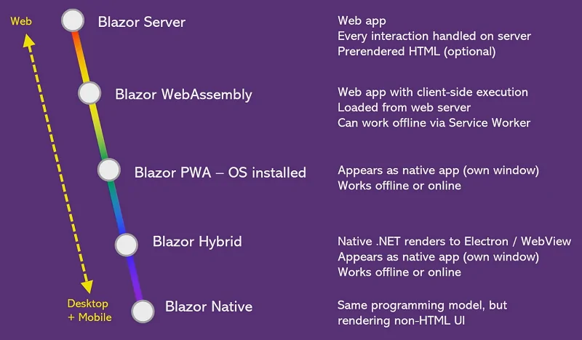
Notes:
Web assembly: tree shaking (linking), target May 2020
https://www.youtube.com/watch?v=qF6ixMjCzHA&list=PLReL099Y5nRd04p81Q7p5TtyjCrj9tz1t&index=19&t=0s
https://gunnarpeipman.com/blazor-roadmap-2019/

Slide 17

Nice, but…
Blazor Server, isn’t it like WebForms?
Didn’t they try this with Silverlight?

Slide 18
Blazor in delaware
Admin / support tools
Micro-frontends after WebAssembly release

Slide 19
Other WebAssembly tools
.NET
Uno: XAML based
Ooui: Xamarin Forms
Non .NET
Yew & Seed: Rust based
Vugu: Go based

Slide 20
WebAssembly
The web’s next-generation

Slide 21
References
Building Full-stack C# Web Apps with Blazor
Blazor Component Lifecycle Diagram
Future of Blazor
The increasing nature of frontend complexity
11 Frontend frameworks that are written with backend languages
Notes:
Questions

